Slide 1
Intro to computer programming project
Aidan DeVera

Slide 2
Goals
Extract the application programming interface(API) from OpenAI in order to create a chatbot
Using pygame, create a user interface(UI) to connect to the chatbot

Slide 3
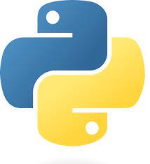

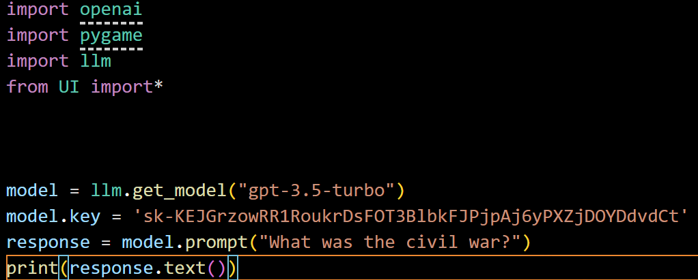
Python Large Language Models + OpenAI
Create an OpenAI key to access their AI model
In VSCode, enable the model and use it to answer a prompt from the user
This code snippet will answer the prompt in the terminal

Slide 4
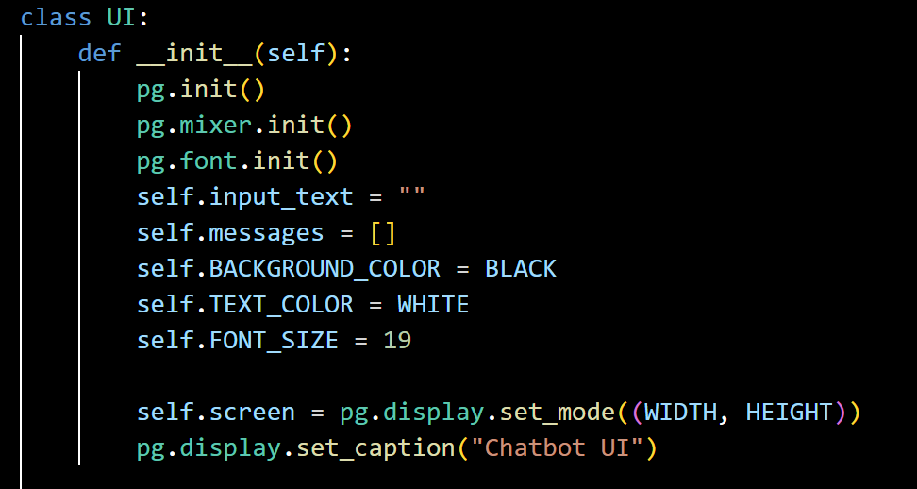
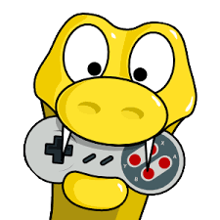
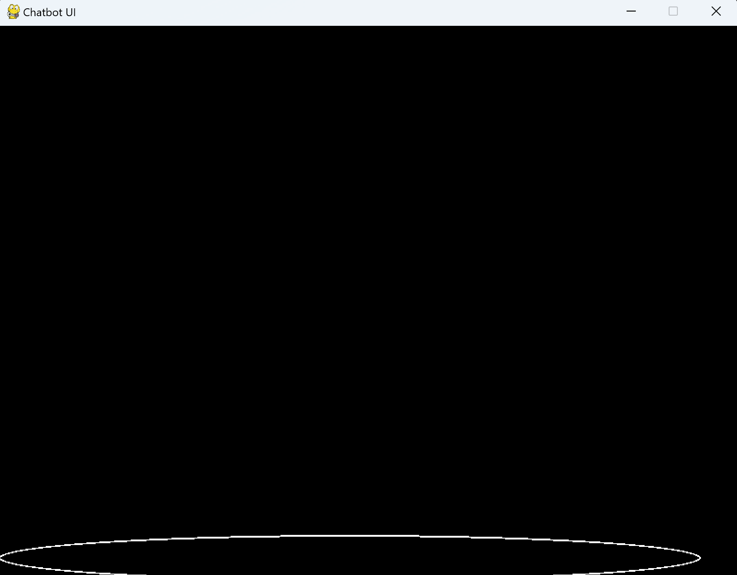
User Interface
Set up the interface with pygame.
Set up the pygame window
The output will display a black screen with a pygame ellipse as a “search bar”

Slide 5
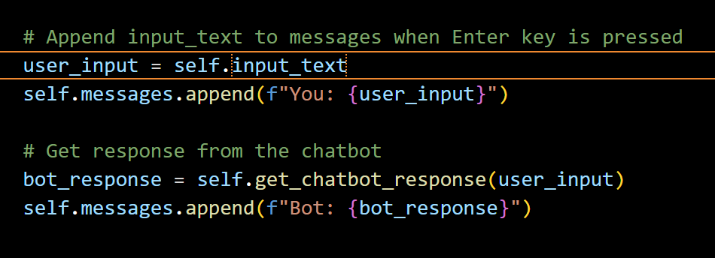
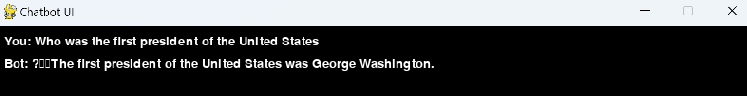
Obtaining data from the user
In order to activate the gpt model in the chatbot, the user must enter a prompt
The chatbot will use the data extracted from OpenAI’s model to answer the prompt.

Slide 6
Problems
The text cuts off at the end of the screen
It is not a conversational model
The model is not fine-tuned with data, therefore it cannot be used for specialized use cases.

